Slide 1


Slide 2
Error Handling & Exception Handling
Notes:
Error handling refers to the response and recovery procedures from error conditions present in a software application.
Exception Handling is an abnormal condition

Slide 3
Error Handling & Exception Handling
Error handling refers to the response and recovery procedures from error conditions present in a software application.
Exception Handling is an abnormal condition that arises in a code sequence at run time. In other words, an exception is a run-time error.

Slide 4
Error Handling VS Exception Handling
Exceptions are those which can be handled at the run time, whereas errors cannot be handled at the run time.
Notes:
Exception Handling is an abnormal condition

Slide 5
Exception Handling
In Java it is handled using 5 keywords
Try
Catch
Throw
Throws
Finally

Slide 6
Using Keywords
try – A block of source code that is to be monitored for exception
catch – It handles the specific type of exception along with the try block.
throw – It is used to throw specific exception from the program code.
throws – It specifies the exception that can be thrown by a particular method.
finally – it specifies the code that must be executed even though exception may or may not be occur.
Notes:
Types of Runtime Exception
Arithmetic Exception
Null Pointer Exception
Number format Exception

Slide 7
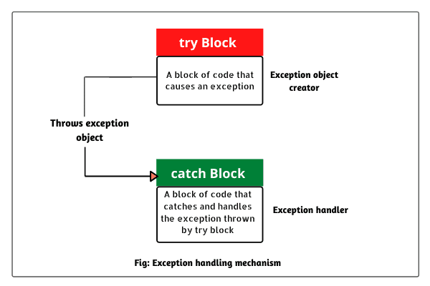
Handling try-catch block
Notes:
try – A block of source code that is to be monitored for exception
throws – It specifies the exception that can be thrown by a particular method.
catch – It handles the specific type of exception along with the try block.

Slide 8
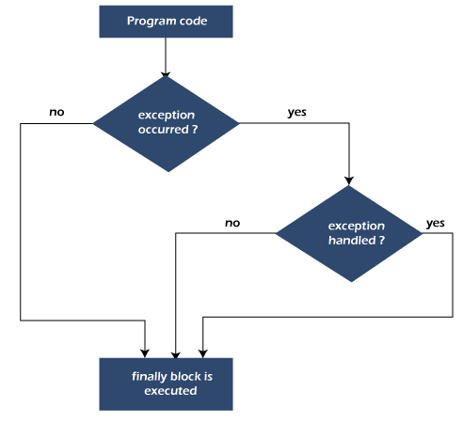
Finally Block

Slide 9
Handling try-catch block( Cont..)
The statement(s) that are likely to cause an exception are enclosed within a try block.
For these statements the exception is thrown.
There is another block defined by the keyword catch which is responsible for handling the exception thrown by the try block.
As soon as exception occurs it is handled by the catch block.
The catch block is added immediately after the try block.
Notes:
try – A block of source code that is to be monitored for exception
catch – It handles the specific type of exception along with the try block.

Slide 10
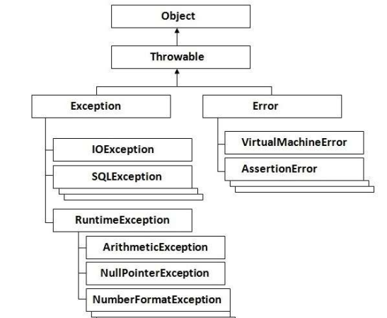
Hierarchy of Exception classes
Notes:
VirtualMachineError is thrown when the Java virtual machine encounters an internal error or resource limitation,
NullPointerException is a runtime exception in Java that occurs when a variable is accessed which is not pointing to any object and refers to nothing or null
The NumberFormatException occurs when an attempt is made to convert a string with improper format into a numeric value.
An assertion is a statement in Java which ensures the correctness of any assumptions which have been done in the program.

Slide 11
Syntax of try- catch
try
{
//exception gets generated here
}
Catch(Type_of_Exception e)
{
//exception is handled here
}
Notes:
try – A block of source code that is to be monitored for exception
catch – It handles the specific type of exception along with the try block.

Slide 12
throws Syntax
type method-name(parameter-list)
throws exception-list
{
// body of method
}
Notes:
throws – It specifies the exception that can be thrown by a particular method.

Slide 13
Example (Unit Level)

Slide 14
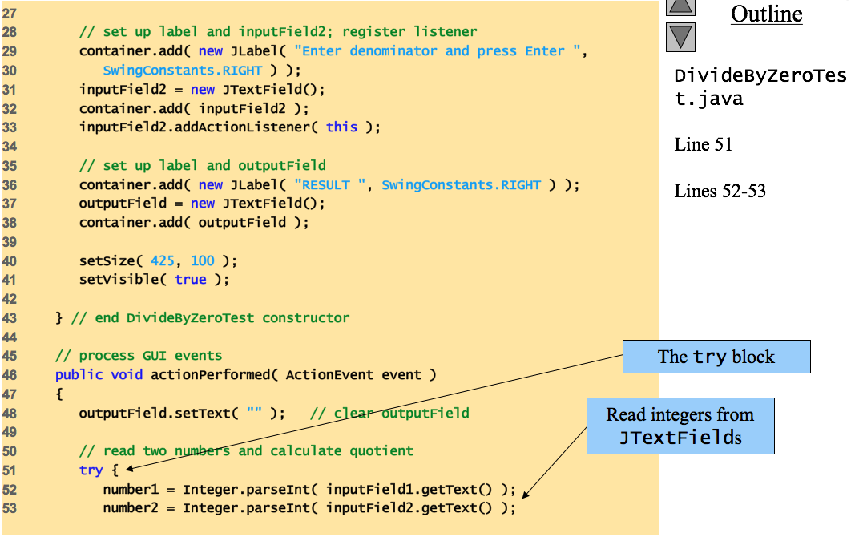
Notes:
try – A block of source code that is to be monitored for exception

Slide 15
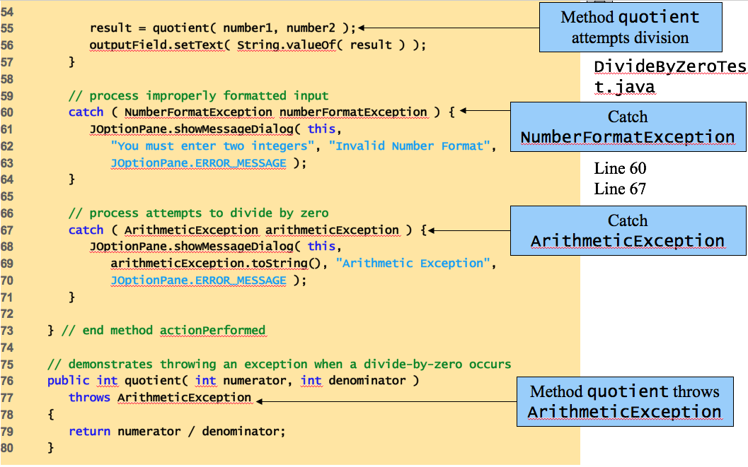
Notes:
catch – It handles the specific type of exception along with the try block.
throws – It specifies the exception that can be thrown by a particular method.
Arithmetic Exception= e.g. Divide By Zero Exception

Slide 16
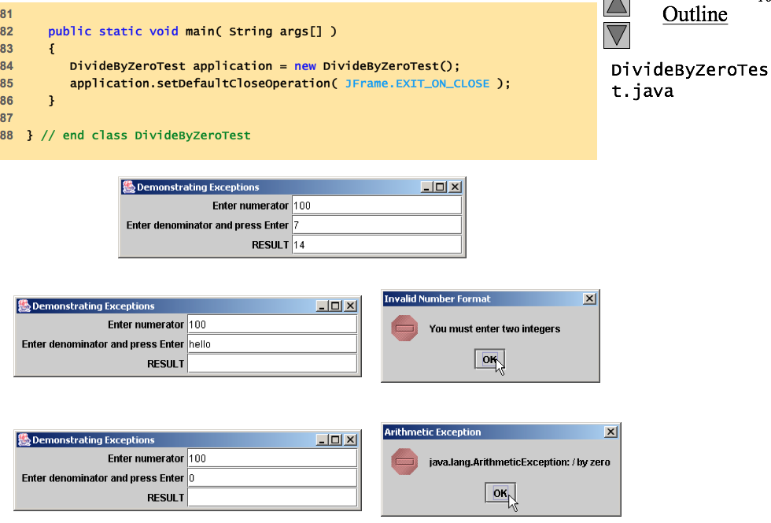

Slide 17
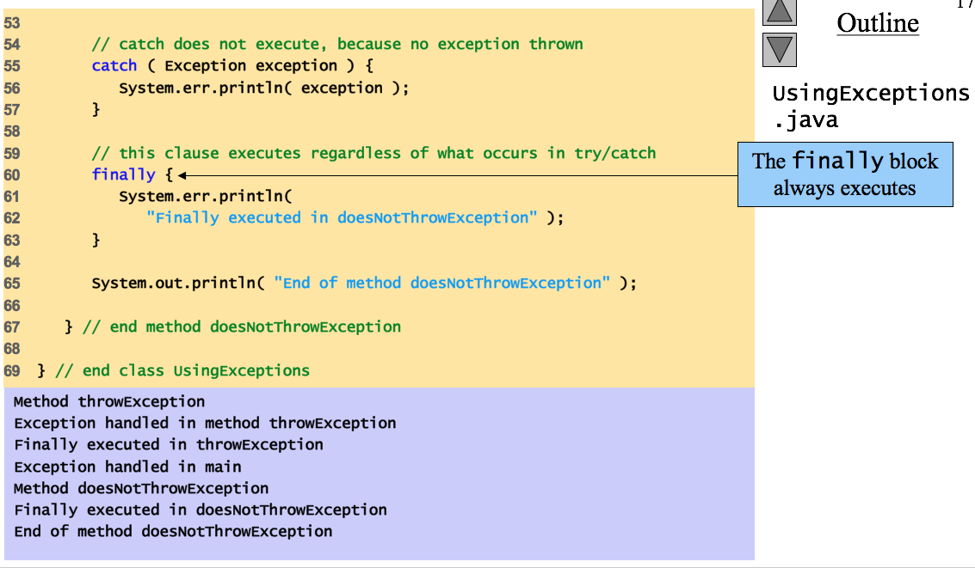
Finally Block Example

Slide 18
Overview of Unit Test
Unit testing represents to monitor your code or program before deployment on server
Unit testing normally perform by Software developer or programmer
Continuous unit testing enhance the efficiency of software application or system

Slide 19
Unit test with Test case
Test case is the primary document which is used to perform the unit test.
Test case is the software metrics that highlight expected and actual output against particular input.
For unit testing, the formation of test case is simple one

Slide 20
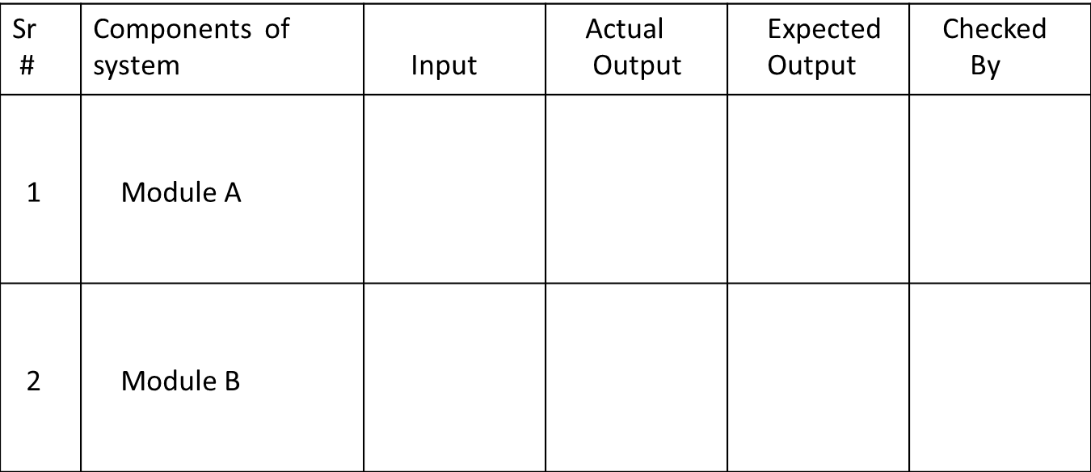
Test case Basic Sample

